Slide 1
SylUI - introduction
Syllabic User Interface by Greg Tonoski, Nostriga 2024, Riga, 23-08-2024.

Slide 2
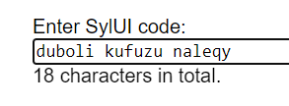
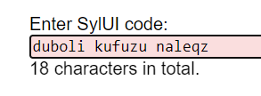
SylUI concept
Sylui is how to (re-)type secrets or random numbers, e.g.
nsec:”duboli kufuzu naleqy lyfety dohihy rutoqa rageli kilyly vetyka himujy teluzi fuoda va”
Goal: strike balance between fewer errors and faster manual entry of secrets (to and from computers).
Error detected

Slide 3
Pain point: “entered credentials are incorrect!”
Unlike other data, secrets entry:
is susceptible to uncorrectable and irrecoverable mistakes (loss, damage),
entails high emotional pressure, frustration and
is slow.

Slide 4
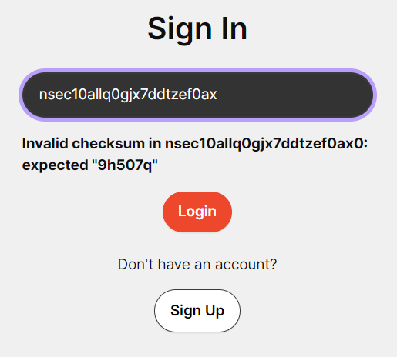
Current state - real life example from iris.to (Nostr)

Slide 5
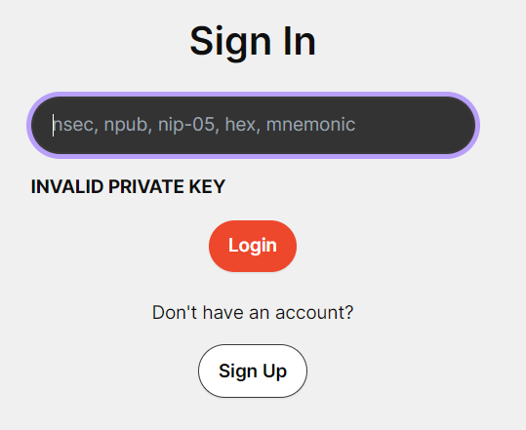
Current state - real life example from iris.to (Nostr) - continued

Slide 6
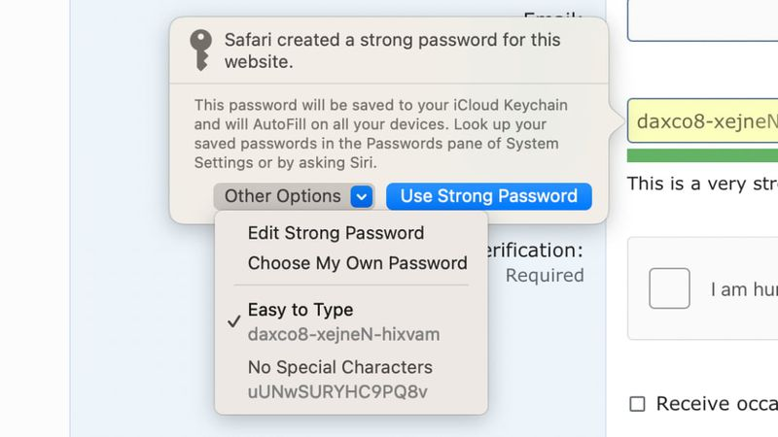
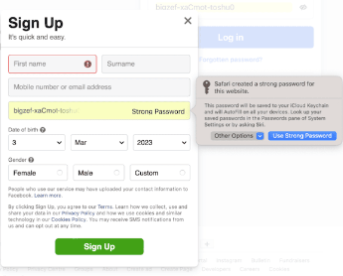
Current state - real life example from MacOS
daxco8-xejneN-hixvam scares a user🤬. What are they supposed to do with it? Memorize? Write it down? Retype? Consider SylUI instead.

Slide 7
Can you read (and retype) these numbers?
1000
123 456
555 555 555
101 202 303 404
740 432 937 515 606

Slide 8
Can you read (and retype) this code?
JZ$!4'9%Om+-W]M

Slide 9
Hands-on experiments: try retyping as fast as you can:
SylUI: duboli kufuzu naleqy lyfety dohihy rutoqa rageli kilyly vetyka himujy teluzi fuoda va
WIF: L3wB8ytuxNS3SPX2CJnHqK48Zzqj1AnayDTrJomvNPDxuKvHyvpT
HEX: C85A FBAC CF3E 1EE4 0BDC D721 A9AD 1341 3447 75D5 1840 EFC0 511E 0182 AE92 F78E
NSec: nsec1epd0htx08c0wgz7u6us6ntgngy6ywaw4rpqwlsz3rcqc9t5j778q75xnrg
[:graph:]: p&D,6TeI}%LKu]O[-UWisH2DHF~43c6LX'L+5EA!
Notes:
SylUI: 73 chars, WIF: 52 chars, hex: 64 chars, NSec: 63 chars.

Slide 10
Are they both the same? Verify.
nsec1v l029mg pspedv a04g90 vlqah6 fvh240 zqtv9k 0t9af8 935ke9 laqsnl
nsec1v l029mg pspedv a04g90 vlzah6 fvh240 zqtv9k 0t9af8 935ke9 laqsnl
Notes:
No. q and z are replaced.

Slide 11
Are they both the same? Verify.
duboli kufuzu naleqy lyfety dolyhy rutoqa rageli kilyly vetyka himujy
duboli kufuzu naleqy lyfety dolyhy rutoza rageli kilyly vetyka himujy
Notes:
No. q and z are replaced.

Slide 12
SylUI - flexible formatting examples
fafifodudaababebyfafifodudaababebyfafifodudaababeby
fafifo dudaa babeby fafifo dudaa babeby fafifo dudaa babeby
fafifo dudaa babeby fafifo dudaa babeby fafifo dudaa babeby
fafi fodu daa babe byfa fifo duda abab eby fafi fodu daa babe by
Any grouping permitted. All examples are equivalent to one another.

Slide 13
Summary
SylUI is intended to be user experience (Ux) improvement. It fits for copying random secret data manually. Works well with both handwriting and keyboards (mechanical and virtual like e.g. ITU-T E.161 phone one).
SylUI could be considered as replacement for BIP39 dictionary, Base94, printable (ASCII) character class etc.
More information: “https://gregtonoski.github.io/sylui/”.

Slide 14
Keywords
human-computer interaction, HCI, typo, transposition, entry errors, encoding, secrets, big number, random number, digital key, passcode.

